Slide 1
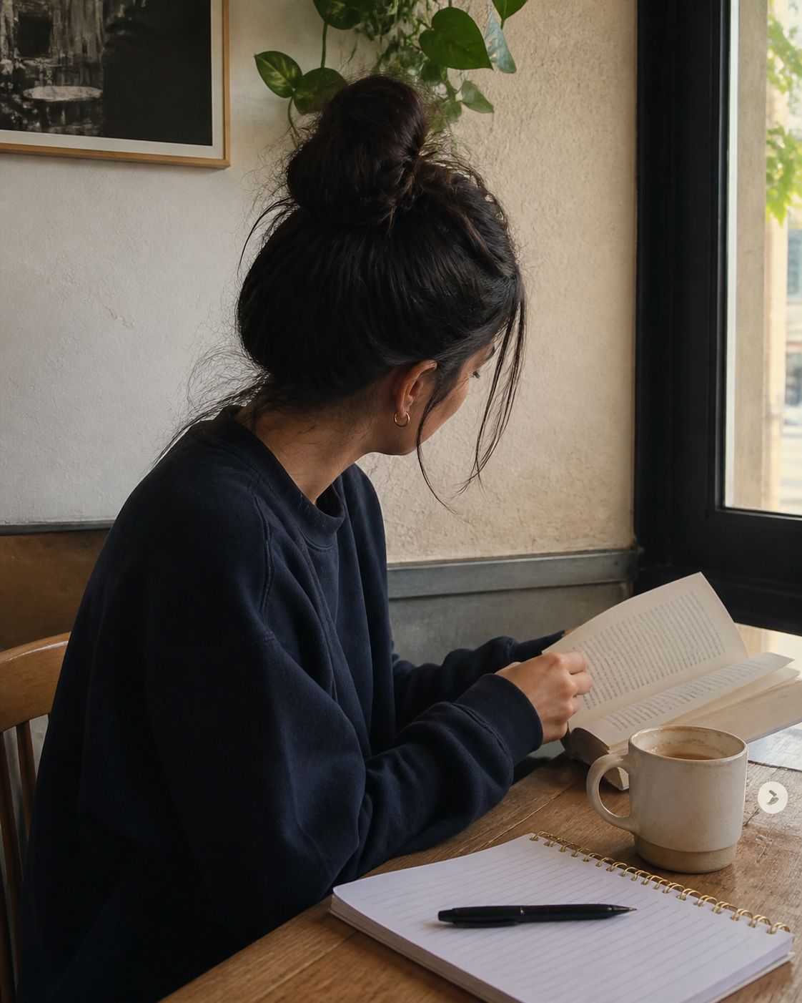
WEEKEND PHOTO DIARY
weekend notes
coffee, a few pages, and nowhere urgent to be.
SAVE THIS FEELING
01 / Cormorant Garamond + DM Sans

Slide 2
WEEKEND PHOTO DIARY
little rituals
small things that made the day softer.
SAVE THIS FEELING
02 / DM Serif Display + DM Sans

Slide 3
WEEKEND PHOTO DIARY
currently loving
soft light, open windows, and flowers that make the room feel awake.
SAVE THIS FEELING
03 / Fraunces + Manrope

Slide 4
WEEKEND PHOTO DIARY
a soft reset
rest is part of the plan.
SAVE THIS FEELING
04 / Libre Baskerville + Plus Jakarta Sans

Slide 5
WEEKEND PHOTO DIARY
a little life update
a walk, a change of pace, and the feeling of coming back to myself.
SAVE THIS FEELING
05 / Bodoni Moda + DM Sans

